Slide 1

KharchaTrack
Smart Expenses Tracker With Insight
By Reman buddhacharya

Slide 2
Introduction
Track expenses using ML
Detect anomalies in spending – Isolation Forest
Forecast future costs – Moving Average
Better financial decisions

Slide 3
Objective
To develop an intelligent expense tracker that forecasts spending trends and detects anomalies using machine learning.

Slide 4
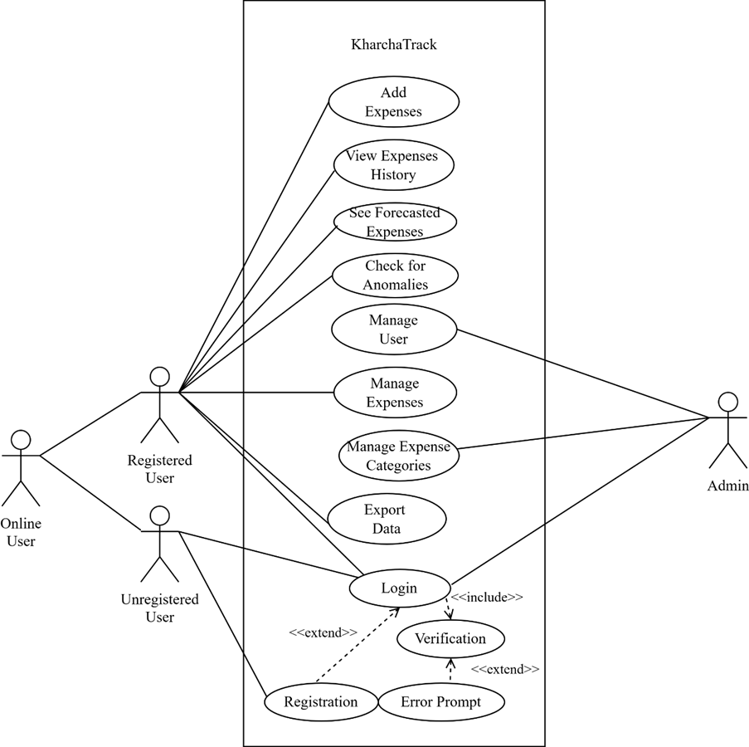
Architecture
USE CASE DIAGRAM

Slide 5
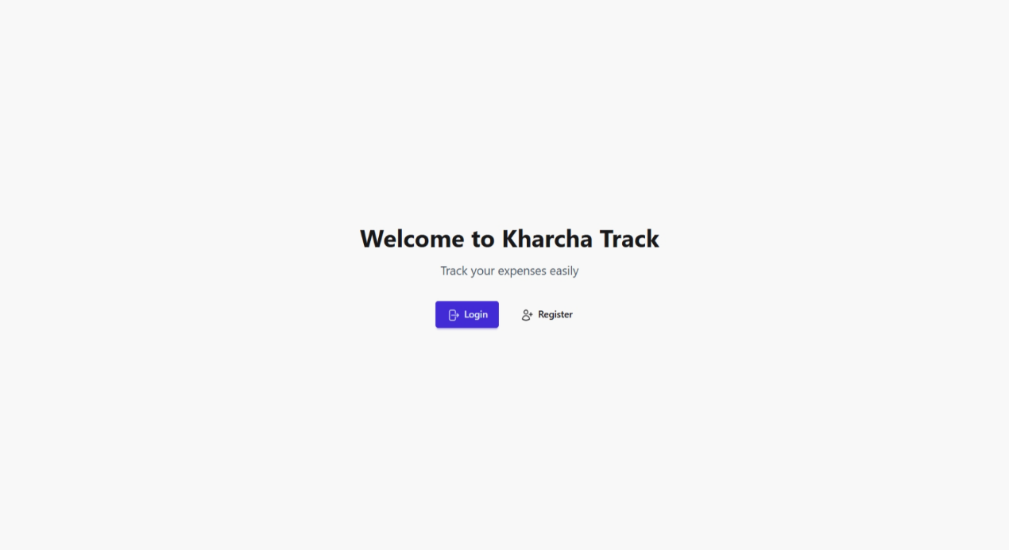
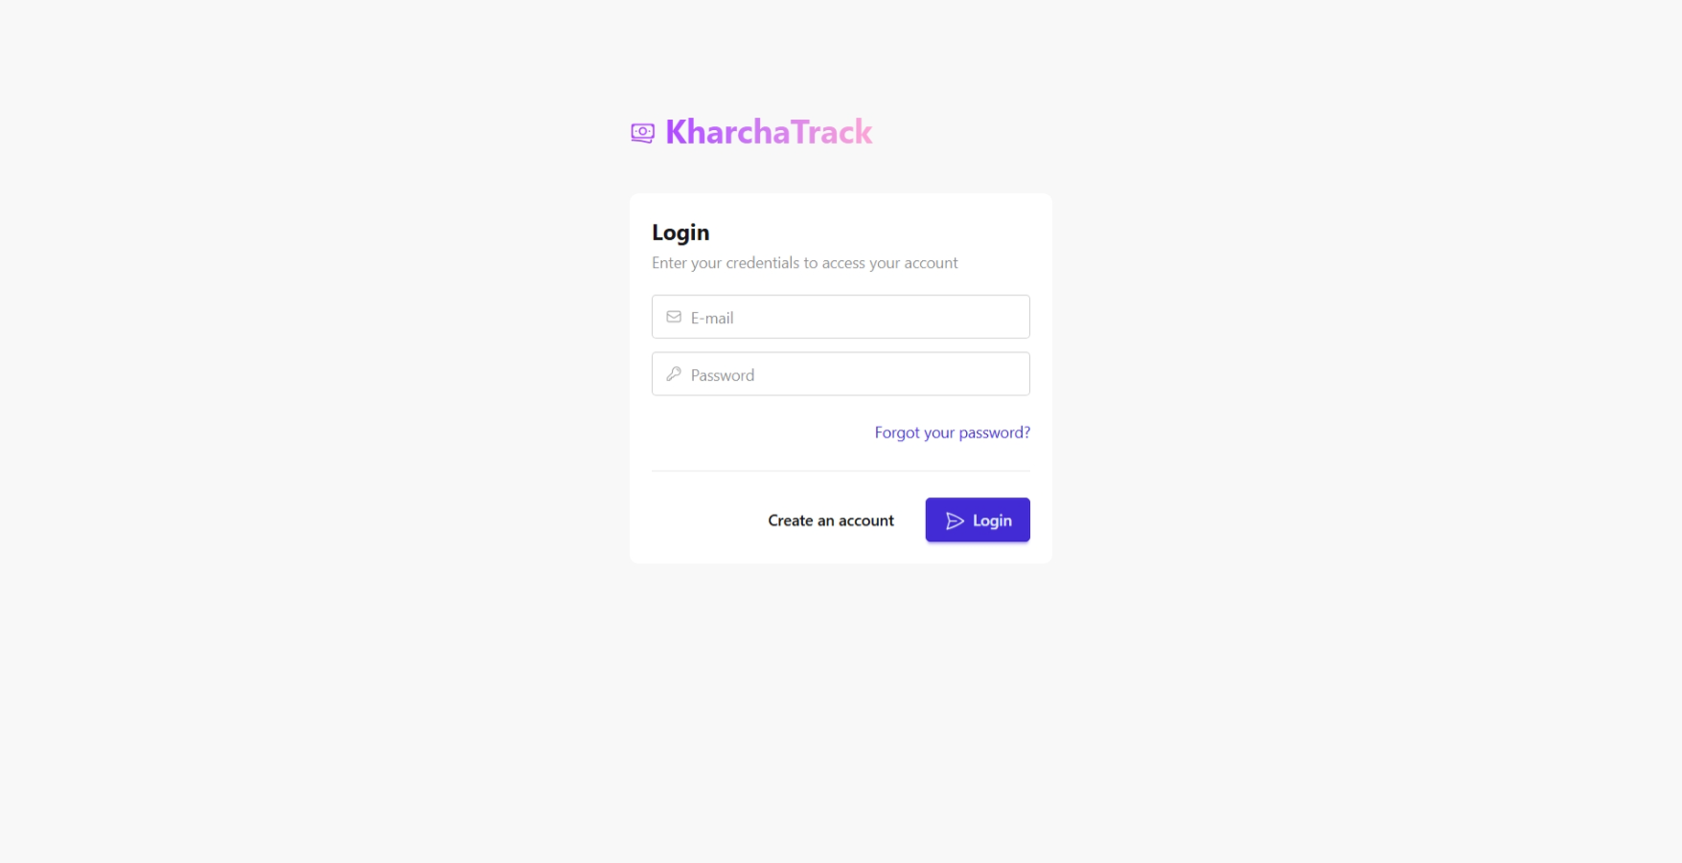
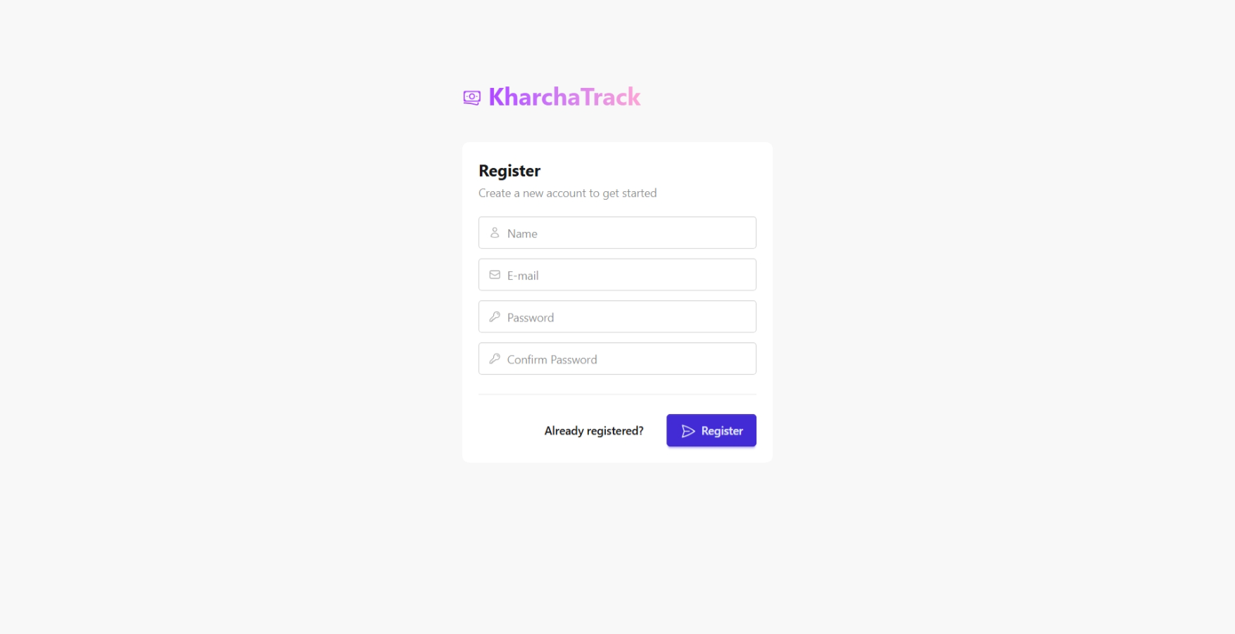
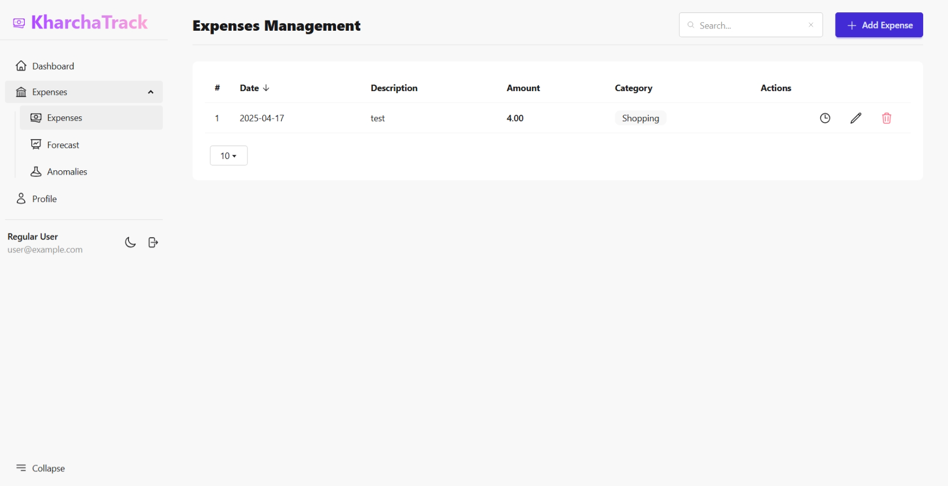
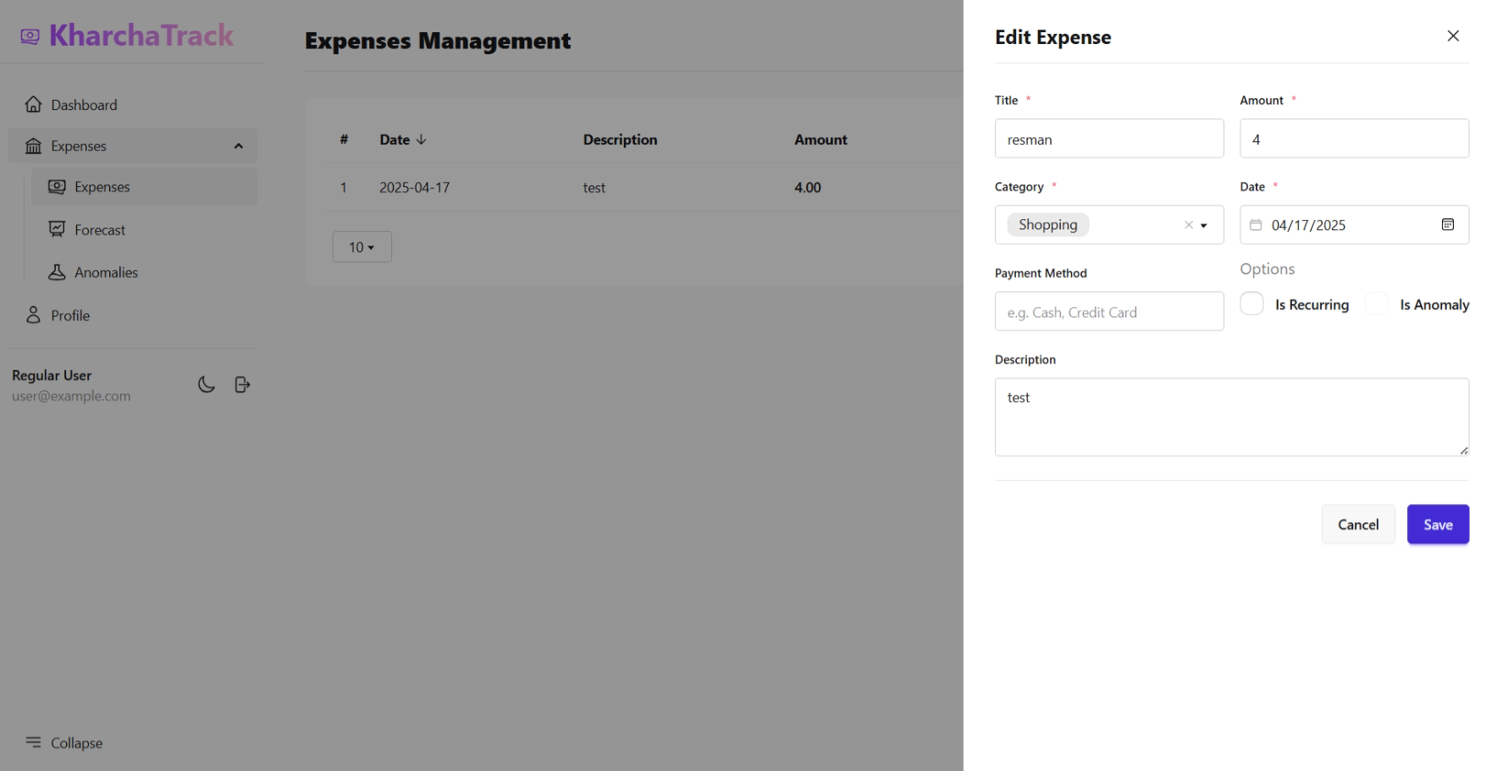
Screenshots

Slide 7
Screenshots

Slide 8
Pending Works
Implement Algorithm
Update Dashboard Charts

Slide 9
Components
Frontend
Livewire, MaryUI
Backend
Livewire Volt
Database
PostgreSQL

Slide 10
Algorithm
Moving Average: expense forecast
Isolation Forest: detect anomalies
Input: historical expense data
Output: prediction and detection
Improve financial awareness

Slide 11
Conclusion
Tracks and analyzes spending smartly
Forecasts expenses using algorithms
Detects spending anomalies fast
Improves budgeting and savings

Slide 12
Thank You
Any queries?

